Slide 1
Parameter-Listen für Multi-Regeln
Manuel Ohrndorf
Praktische Informatik
Universität Siegen

Slide 2
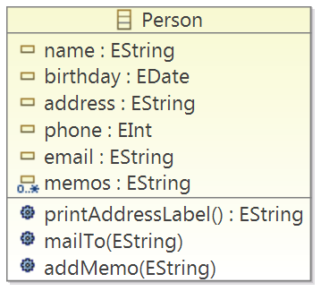
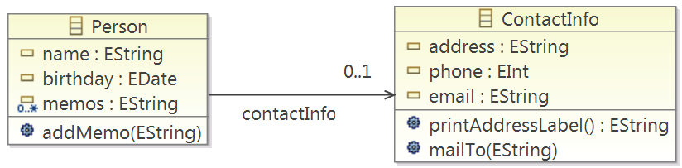
Motivation
Extract Class

Slide 3
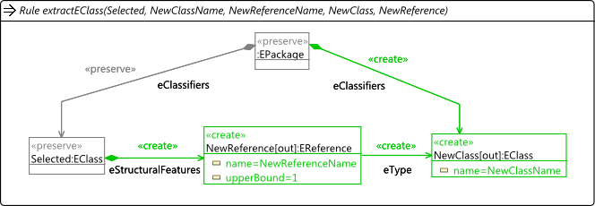
Henshin Transformation – Kernel-Regel
Input Parameter

Slide 4
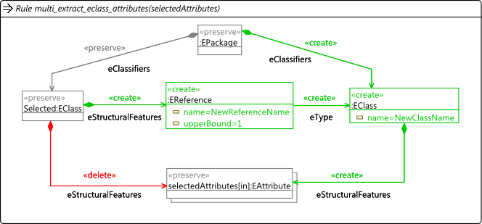
Henshin Transformation – Multi-Regel
Input Parameter-Liste

Slide 5
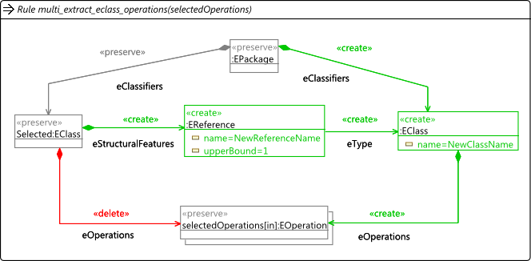
Henshin Transformation – Multi-Regel
Input Parameter-Liste

Slide 6
Ausführen der Regeln
Exract Attribute
Exract Operation
Selected Attributes
Selected Operations
Match 1
address
Match 4
printAddressLabel()
Match 2
phone
Match 5
mailTo()
Match 3
email

Slide 7
Semantik der Regeln
amalgamation-unit(unit-para_1, … , unit-para_n)
  kernel-regel(rule-para_1, … , rule-para_i)
  multi-regel_1(multi-para_1.1, … , multi-para_1.j)
  …
  multi-regel_m(multi-para_m.1, … , multi-para_m.k)
  mapping<unit-para -> rule-para | multi-para>
rule-para ∈ {value, object}
multi-para ∈ {value, object, list}
Grundlegende Semantik bleibt erhalten:
Eine Amalgamation-Unit ist anwendbar, wenn die Kern-Regel anwendbar ist.
Multi-Regel 1
Multi-Regel 2
parameter-list_1.1
parameter-list_2.1
Match 1
value/object
Match 4
value/object
Match 2
value/object
Match 5
value/object
Match 3
value/object

Slide 8
Semantik der Regeln
amalgamation-unit(unit-para_1, … , unit-para_n)
  kernel-regel(rule-para_1, … , rule-para_i)
  multi-regel_1(multi-para_1.1, … , multi-para_1.j)
  …
  multi-regel_m(multi-para_m.1, … , multi-para_m.k)
  mapping<unit-para -> rule-para | multi-para>
rule-para ∈ {value, object}
multi-para ∈ {value, object, list}
Kein Match für einen einzelnen Parameterwert.
Multi-Regel 1
parameter-list_1.1
Match 1
value/object
value/object
Match 2
value/object

Slide 9
Semantik der Regeln
amalgamation-unit(unit-para_1, … , unit-para_n)
  kernel-regel(rule-para_1, … , rule-para_i)
  multi-regel_1(multi-para_1.1, … , multi-para_1.j)
  …
  multi-regel_m(multi-para_m.1, … , multi-para_m.k)
  mapping<unit-para -> rule-para | multi-para>
rule-para ∈ {value, object}
multi-para ∈ {value, object, list}
Mehrere Matches für einen einzelnen Parameterwert.
Multi-Regel 1
parameter-list_1.1
Match 1
Match 2
value/object
Match 3
value/object

Slide 10
Semantik der Regeln
amalgamation-unit(unit-para_1, … , unit-para_n)
  kernel-regel(rule-para_1, … , rule-para_i)
  multi-regel_1(multi-para_1.1, … , multi-para_1.j)
  …
  multi-regel_m(multi-para_m.1, … , multi-para_m.k)
  mapping<unit-para -> rule-para | multi-para>
rule-para ∈ {value, object}
multi-para ∈ {value, object, list}
Fehlende Parameterwerte.
Multi-Regel 1
parameter-list_1.1
parameter-list_1.2
parameter-list_1.3
Match 1
value | object
value | object
x
Match 2
value | object
value | object
x
Match 3
value | object
x
x

Slide 11
Semantik der Regeln
amalgamation-unit(unit-para_1, … , unit-para_n)
  kernel-regel(rule-para_1, … , rule-para_i)
  multi-regel_1(multi-para_1.1, … , multi-para_1.j)
  …
  multi-regel_m(multi-para_m.1, … , multi-para_m.k)
  mapping<unit-para -> rule-para | multi-para>
rule-para ∈ {value, object}
multi-para ∈ {value, object, list}
Normales Amalgamation-Unit Verhalten.
Multi-Regel 1
parameter-list_1.1
parameter-list_1.2
parameter-list_1.3
Match 1
x
x
x
…
x
x
x
Match N
x
x
x

Slide 12
Semantik der Regeln
amalgamation-unit(unit-para_1, … , unit-para_n)
  kernel-regel(rule-para_1, … , rule-para_i)
  multi-regel_1(multi-para_1.1, … , multi-para_1.j)
  …
  multi-regel_m(multi-para_m.1, … , multi-para_m.k)
  mapping<unit-para -> rule-para | multi-para>
rule-para ∈ {value, object}
multi-para ∈ {value, object, list}
Normales Amalgamation-Unit Verhalten & Parameter-Listen.
Multi-Regel 1
Multi-Regel 2
parameter-list_1.1
parameter-list_2.1
Match 1
x
Match 1
value | object
…
x
Match 2
value | object
Match N
x
Match 3
value | object

Slide 13
Hands on...
...Live Demo

